Slide 1
RAISE SUPPORT REQUEST TO EMC
Call hotline +84 12032266/67
Call EMC Vietnam engineer
Call and notify issue/problem situation
Provide serial number of product
Provide situation of issue/problems
Send email and add more information if needed
Get number of created suport request
SUPPORT
REQUEST
CREATED
Fill in information, select product then press Submit button to raise request
Select device in base
Log in
Using https://support.emc.com/

Slide 2
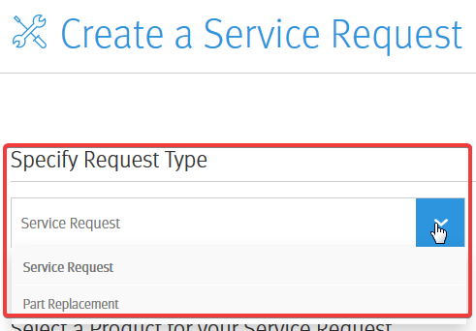
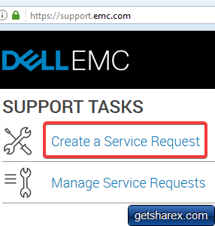
Username: dung.le@lgcns.com
Password: LGDVH_CNSAdm2017
Select Service Request or Part Replacement if need to replace fault hardware

Slide 3
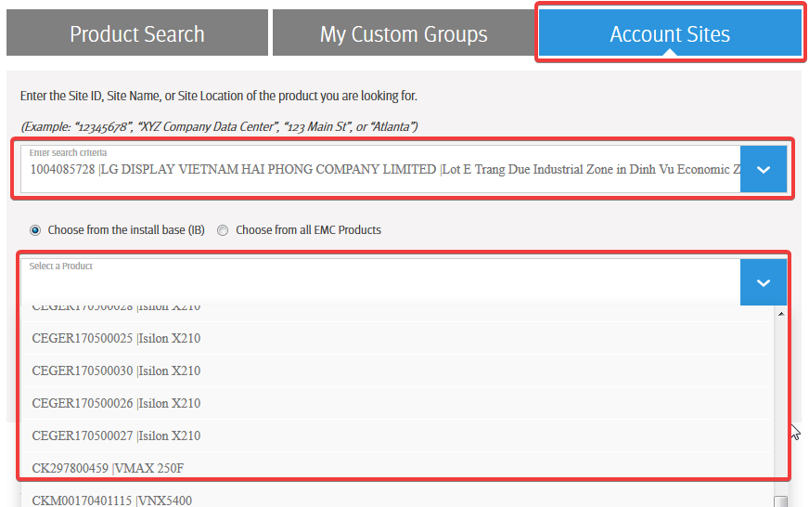
Select Account Sites and select LG Display Vietnam Hai Phong then select device(s) need support from list

Slide 4
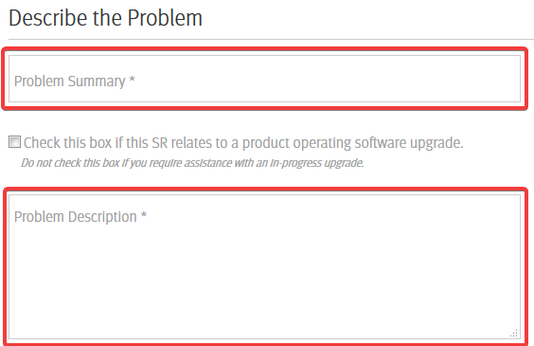
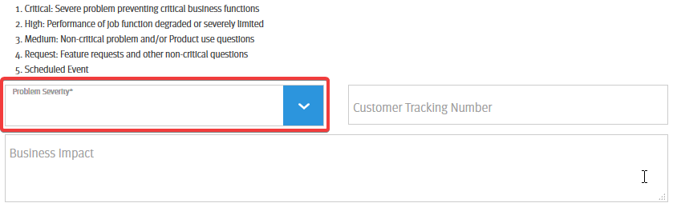
Fill in information in summary and description then select problem severity and fill in business impact

Slide 5
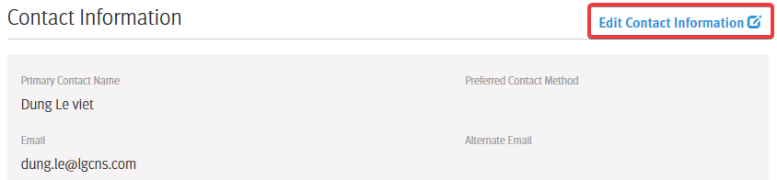
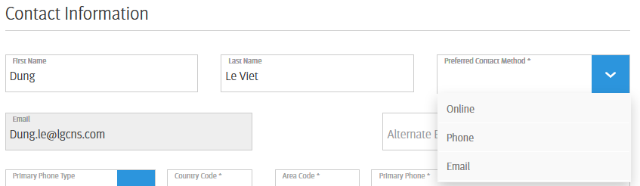
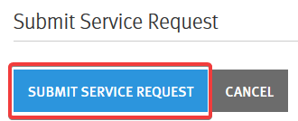
Click Edit Contact Information if you need to change contact information then click Submit Service Request to create SR

Slide 6
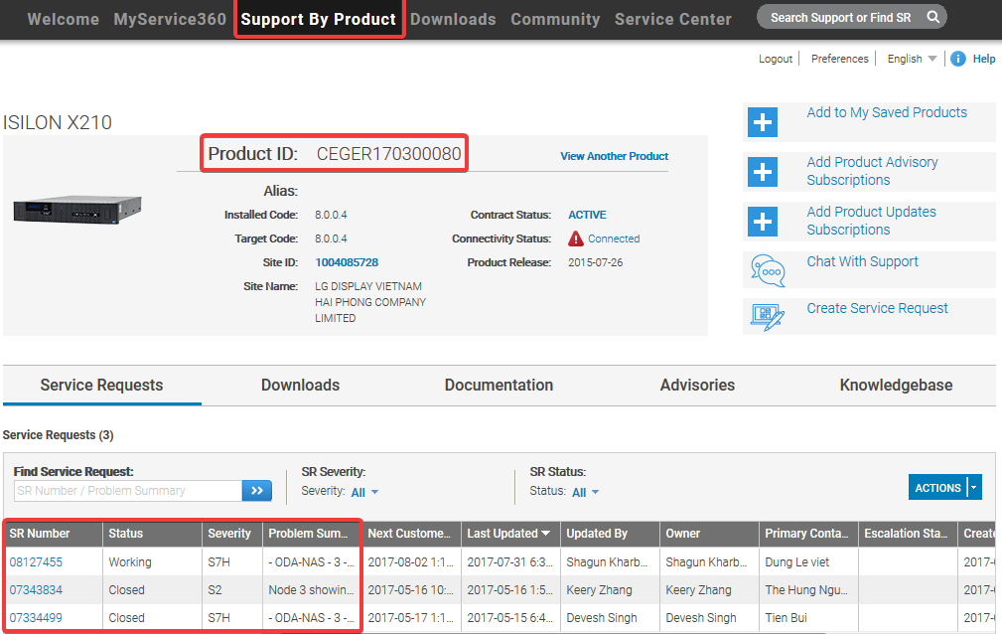
In Support Website we can see information for created suport request

